Slide 1



Slide 2

Build your portfolio project (Week 3): Presentation

Slide 3

E-Learning Platform with Progress Tracking.

Slide 4

ALX C22
RODGERS MARAGIA
10 SEP 24

Slide 5

Inspiration
The increasing need for individualized and accessible education prompted the development of a E-Learning Platform with Progress Tracking. In today's fast-paced digital environment, learners require adaptable platforms that accommodate their schedules and learning styles.
By including progress monitoring, this project enables users to track their progress, set attainable goals, and remain motivated. The software also helps educators by giving insights about student engagement and course effectiveness.
This project is in accordance with the current trend in online education and strives to improve learning experiences by providing interactive information, self-paced learning, and real-time feedback on progress.

Slide 6

Technology &Architecture
Front-End
The front-end of the E-Learning Platform is built using React.js for a dynamic and responsive user interface. Key pages include the Course Catalog, Course Details, and User Dashboard. It allows users to browse courses, track their learning progress, and view course content interactively. The front-end communicates with the back-end via REST APIs and provides a seamless user experience through routing, user authentication, and progress visualization. Styling is enhanced using frameworks like Bootstrap or Material-UI, ensuring a professional and clean design across different devices.

Slide 7

Cont' Technology &Architecture
Back-End
The back-end is powered by Django (or Flask), managing the server-side logic, API handling, and database operations. It includes user authentication, course management (CRUD operations for courses, lessons, and quizzes), and progress tracking.
The back-end uses PostgreSQL or MySQL for database management to store user data, courses, and progress details. REST APIs connect the back-end with the front-end, ensuring smooth data flow for user interactions. Security features like JWT tokens or Django’s built-in authentication are implemented for secure access and data protection.

Slide 8

Core algorithms & Code snippet
I have independently worked on the E-Learning Platform with Progress Tracking, taking full responsibility for both front-end and back-end development. The process involved extensive planning, research, and implementation of key features like user authentication, progress tracking, and course management. I adhered to a structured timeline, dividing tasks into weekly milestones to ensure steady progress. Although I worked alone, I regularly sought feedback from peers and mentors to refine the project and maintain best practices throughout the development phase.
Some Code algorithms you can check on my Github Repository.

Slide 9

Challenges
Integration of Front-End and Back-End:
One of the key challenges was ensuring smooth communication between the React front-end and the Django/Flask back-end through REST APIs. Synchronizing data flow, handling errors effectively, and maintaining consistency in requests and responses took careful planning and debugging.
Progress Tracking Logic:
Designing a robust algorithm to accurately track and update user progress for each course proved challenging. Ensuring the system efficiently handles various edge cases, such as partial completion or skipped lessons, required multiple iterations.
User Authentication and Security:
Implementing secure user authentication was crucial. Encrypting passwords, preventing unauthorized access, and managing secure sessions involved integrating JWT tokens and ensuring data protection, which added complexity to the back-end setup.

Slide 10
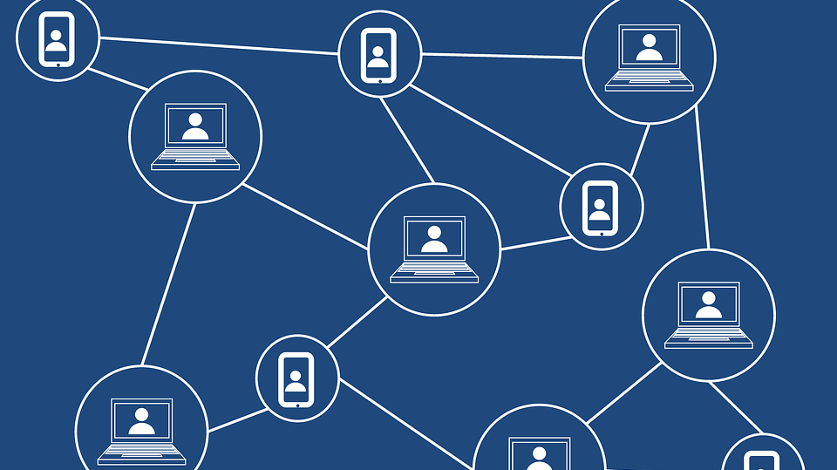
Learnings about technical interests as a result of this project
Working on this E-Learning Platform project has deepened my interest in full-stack development, especially the integration of front-end and back-end systems. I developed a strong appreciation for API design and how crucial it is for smooth communication between components.
Additionally, I gained valuable insights into data security and user authentication, sparking my curiosity to explore more about cybersecurity practices. The process of implementing algorithms like progress tracking also enhanced my interest in data-driven applications, motivating me to dive deeper into algorithms and automation in web development.

Slide 11


Q&A

Slide 12
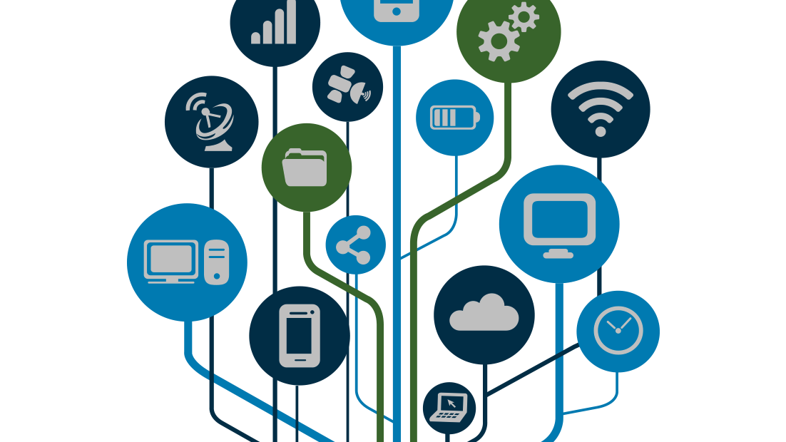
END
Thank You.

